Slide 1
CG2271 Real Time Operating Systems
Lab Lecture 2
GPIO Programming
(Reference Guide Chapter 41)

Slide 2
General Purpose I/O
General Purpose I/O or GPIO pins provide binary input and output.
  Ideal for reading switches and driving LEDs.
  Input and output voltages on the MCXC444 chip is 3.3 volts, NOT 5 volts!

Slide 3
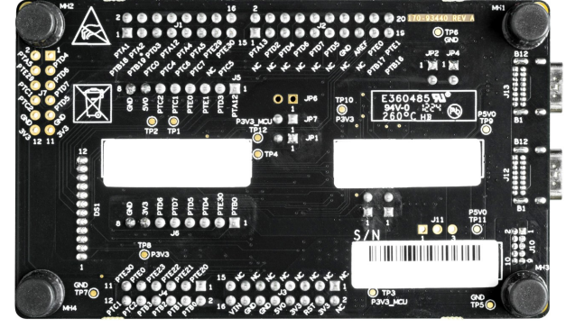
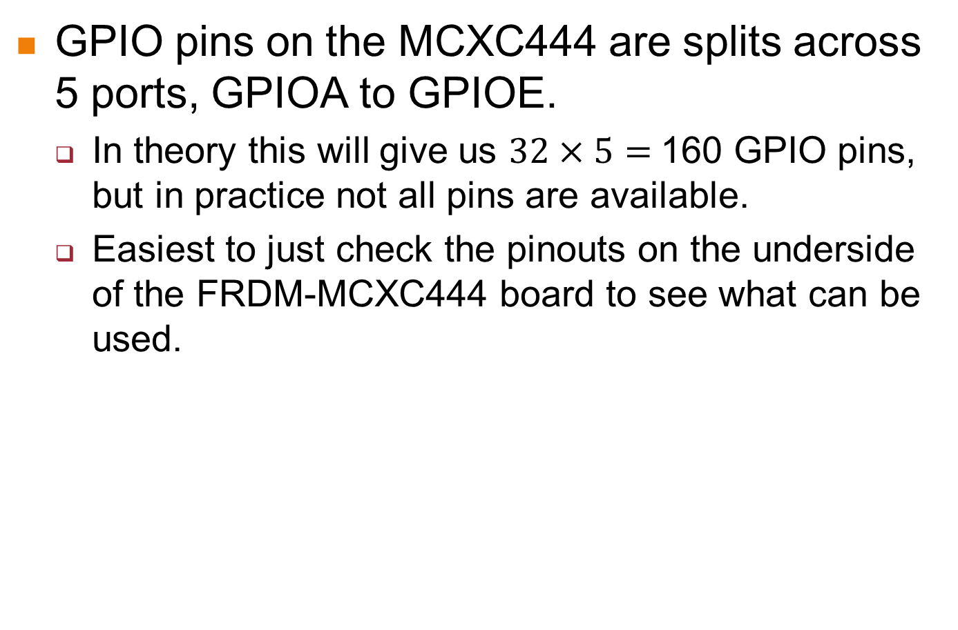
GPIO on the MCXC444
GPIO pins on the MCXC444 are splits across 5 ports, GPIOA to GPIOE.
  In theory this will give us $32×5=$160 GPIO pins, but in practice not all pins are available.
  Easiest to just check the pinouts on the underside of the FRDM-MCXC444 board to see what can be used.

Slide 4
Power Management on the MCXC444
Almost all hardware on the MCXC444 is switched off by default, to save power.
  I2C, SPI, UART, ADC, timers, GPIO, DMA, etc.
Before using these devices, you need to set the corresponding bit in the correct System Clock Gating Control Register (SCGC).
  Part of the System Integration Module (SIM).
  Reference Guide: Sections 12.3.8 to 12.3.11
For GPIO, the clock gating control bits are in the SIM_SCGC5 register.

Slide 5
Power Management on the MCXC444
To turn on the clock for GPIOx (Replace x with A, B, C, D or E. E.g. GPIOE)
  SIM->SCGC5 |= SIM_SCGC5_PORTx_MASK;
  E.g. to turn on GPIOE
  SIM->SCGC5 |= SIM_SCGC5_PORTE_MASK;
To turn off:
  SIM->SCGC5 &= ~SIM_SCGC5_PORTx_MASK;

Slide 6
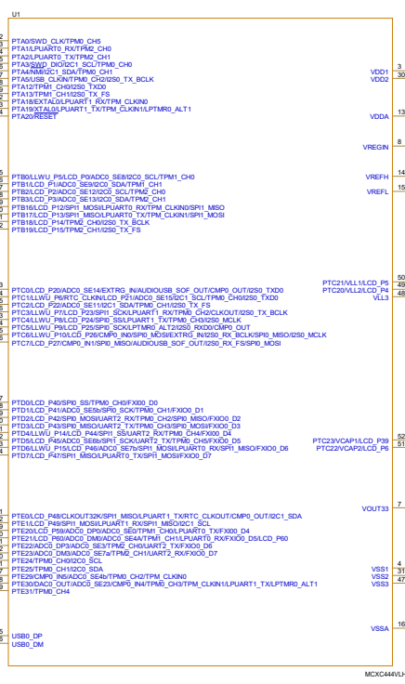
Pin Multiplexing on the MCXC444
Like all microcontrollers, the MCXC444 uses each pin for multiple purposes:
  E.g. PTA1 (Port A pin 1) is shared with the receive pin of low power UART 0 (LPUART0), and channel 0 of timer 2 (TPM2)

Slide 7
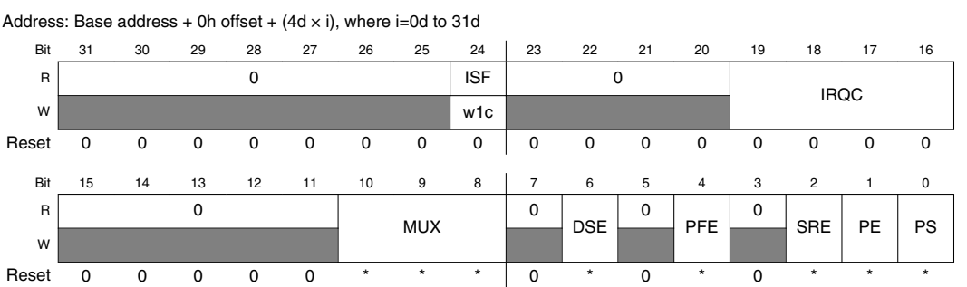
Pin Multiplexing on the MCXC444
We make use of the Pin Control Register (PCR) of each pin to choose the function we want, along with other configurations:
  E.g. PORTA_PCR5 configures pin 5 of port A. (See Section 11.7.1 for details)

Slide 8
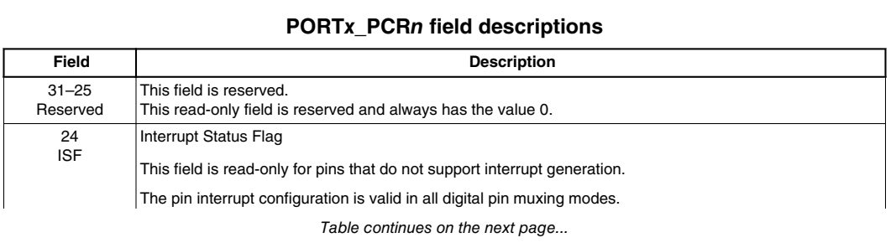
Pin Multiplexing on the MCXC444

Slide 9
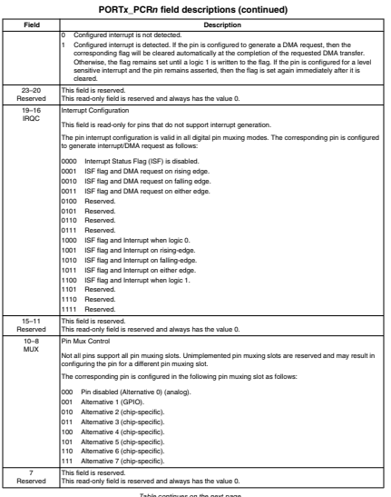
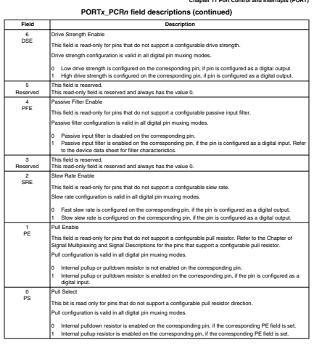
Pin Multiplexing on the MCXC444

Slide 10
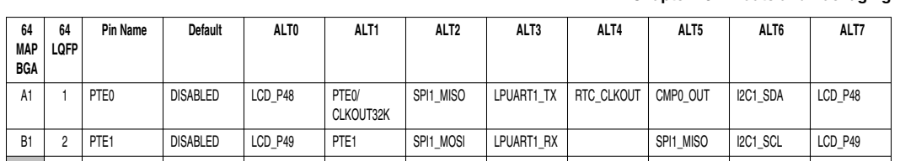
Choosing the Pin Function
We make use of the MUX bits in the PORTx_PCRy register (pin y of port x).
  The tables in Section 10.3.1 show us which number to use for each function.
  For example, if we wanted to use GPIO on PTE1, the correct function is ALT1.

Slide 11
Choosing the Pin Function
We access PORTx_PCRy using:
  PORTx->PCR[y]
Example to choose GPIO for pin PTE1:
  // Zero all the MUX bits
  PORTE->PCR[1] &= ~PORT_PCR_MUX_MASK;
  // Choose ALT1 for PTE1
  PORTE->PCR[1] |= PORT_PCR_MUX(1);

Slide 12
Setting the Pin Direction
Pins can be input or output. To set the direction, we set the corresponding bit in the GPIOx_PDDR (pin data direction register):
  0 – Pin is input, 1 – pin is output
  // Set pin pinnum on port x as input
  GPIOx->PDDR &= ~(1 << pinnum);
  // Set pin pinnum on port x as output
  GPIOx ->PDDR |= (1 << pinnum);
  // Set PTE1 as input
  GPIOE->PDDR &= ~(1 << 1);

Slide 13
Writing to the GPIO pin
To write to a GPIO pin we must first set it as output. Here we use PTE1 as an example:
  // Set PTE1 as output
  GPIOE->PDDR |= (1 << 1);
We now have several choices on how to set/clear/toggle the GPIO pin:
  GPIOx_PCOR: Write a 1 to clear the pin
  GPIOx_PSOR: Write a 1 to set the pin
  GPIOx_PDOR: Write a 1 to set and a 0 to clear
  GPIOx_PTOR: Write a 1 to toggle the pin

Slide 14
Writing to the GPIO pin
Example to clear PTE1:
  #define PIN1 1
  // Set PTE1 to output
  GPIOE->PDDR |= (1 << PIN1);
  // Clear PTE1
  GPIOE->PCOR |= (1 << PIN1);
  // Set PTE1:
  GPIOE->PSOR |= (1 << PIN1);
  // Toggle PTE1:
  GPIOE->PTOR |= (1 << PIN1);

Slide 15
Reading a GPIO Pin
To read a GPIO pin, we set the pin as input and then use the GPIOx_PDIR register. We take PTB2 as an example.
  #define PIN2 2
  // Set PTB2 as input
  GPIOB->PDDR &= ~(1 << PIN2)
  // If PTB2 is 1 do something
  if(GPIOB->PDIR & (1 << PIN2)) {
  .. Do something ..
  }

Slide 16
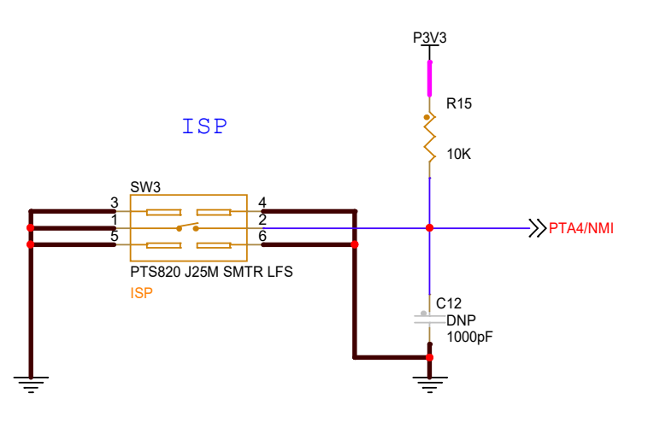
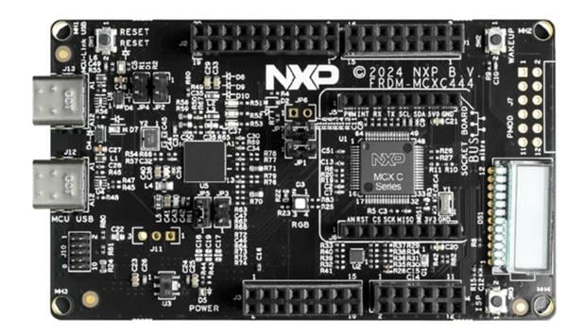
Putting it All Together
We will now study an example where we use a switch on the FRDM-MCXC444 board to toggle an LED.
  We will use switch SW3 on the bottom right of the board, which is connected to PTA4:
    Note that the switch is active-low.

Slide 17
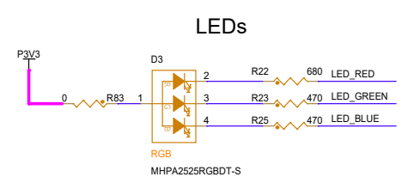

Putting it All Together
The FRDM-MCXC444 board comes with an RGB LED configured in active-low configuration (i.e. we write a 0 to turn on the LED and a 1 to turn it off).
  We will use the red LED, connected to PTE31

Slide 18

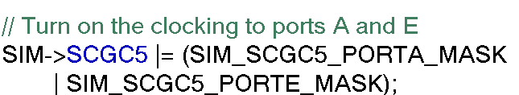
Putting it All Together
Steps:
  Define our pin numbers:
  Turn on the clocking to Ports A and E:

Slide 19
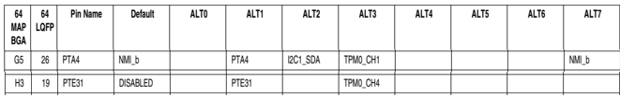
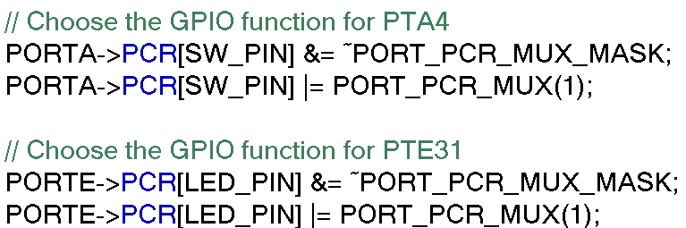
Putting it All Together
Steps:
  Select the correct pin function for PTA4 and PTE31:

Slide 20
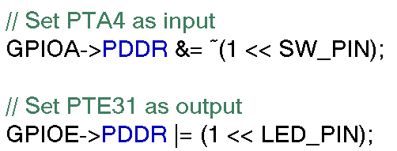
Putting it All Together
Set the switch at PTA4 and the LED at PTE31 as input and output respectively.
Switch off the LED.

Slide 21
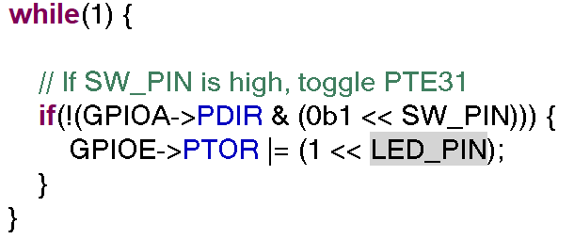
Putting it All Together
Finally poll the switch at PTA4 and toggle the LED at PTE31 whenever it is pressed.

Slide 22
Conclusion
In this lecture we’ve looked at how to configure, read and write GPIO pins on the MCXC444.
In the next lecture we will look at the interrupt architecture on this chip, and how to program the GPIO interrupts.

